Slide 1
I’m Going to a BSO Concert!

Slide 2
Notes for Teachers
Social stories serve 2 functions:
Help preview a social situation with your students so they know what to expect (reduce anxiety)
Teach students what is expected of them in these situations so they are able to demonstrate expected behaviors.
Feel free to print and bring this book with you so you can use it in the moment to prompt a student of expected behaviors. Even without the book, you can still use consistent language from this story to remind students of the expectations that have been set.
This social story is designed to be customizable to your unique students and situation.
On slide 2, please edit the dates to reflect the performance you will be attending.
On slides 4-5, please edit the text and photo to reflect the transportation your students should be prepared for.
On slides 19-20, please edit the text and add a photo or image to represent how your students will get back home and what the plan for lunch will be.
Slide 10 is only relevant if you are attending pre- or post-concert activities/demonstrations. If not, you may delete this slide.
– Lynn Rubin, BSO Educators Advisory Council

Slide 3
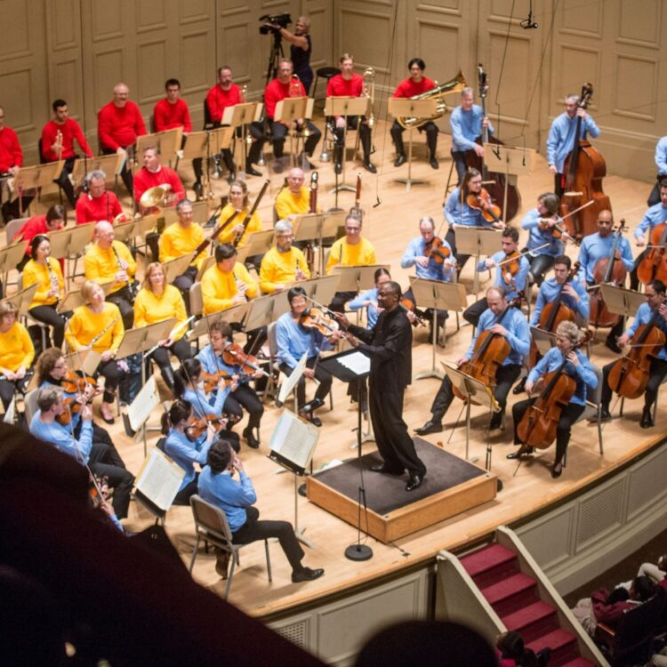
On Wednesday/Thursday/Friday, October 25/26/27 I am going on a field trip to see and hear the Boston Symphony Orchestra with my teacher and classmates.
You might notice the musicians’ colorful shirts. Each “Instrument Family” has its own color!

Slide 4
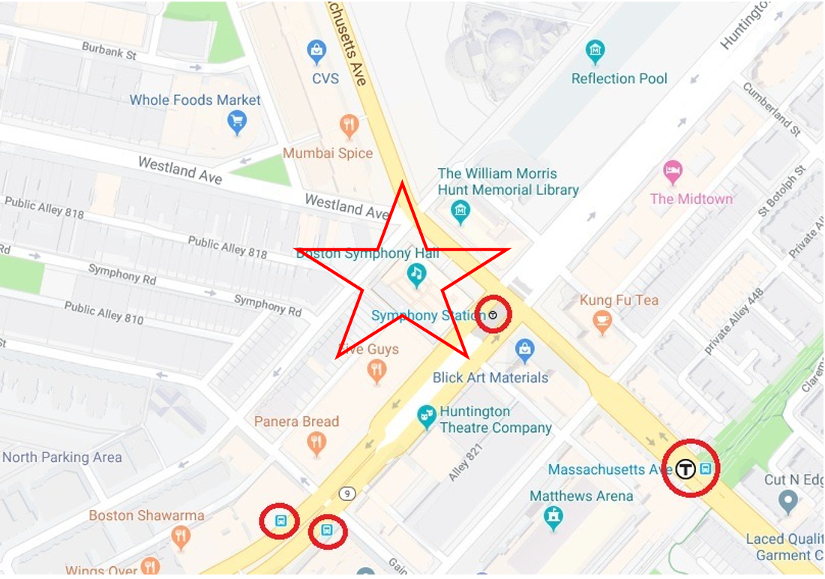
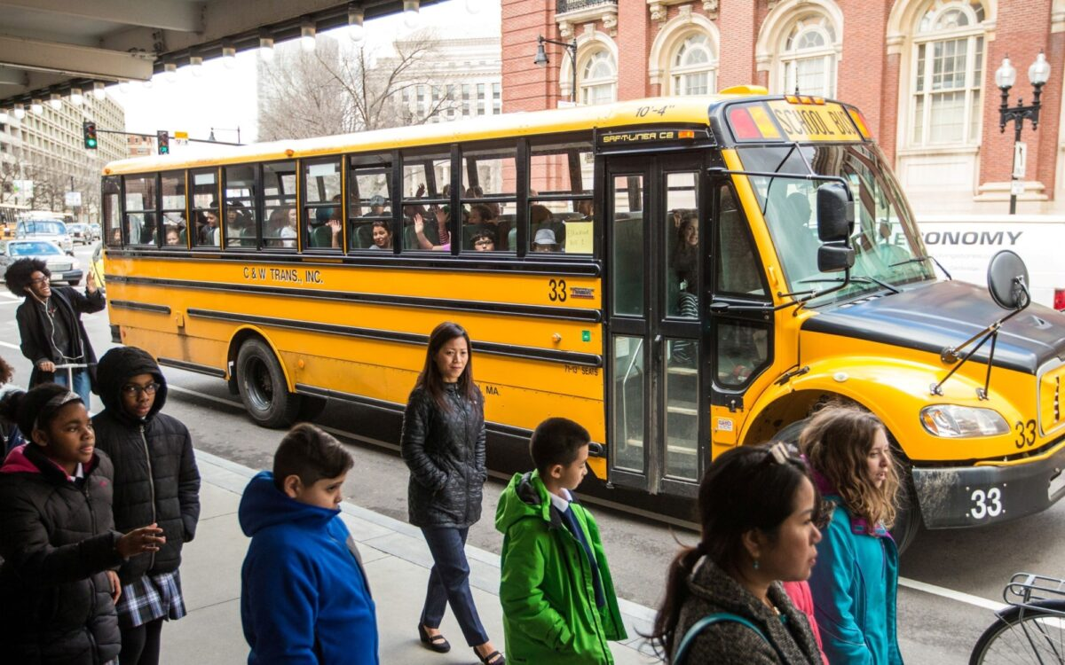
Teachers - please edit this slide for your situation.
Ideas include:
Time you will leave school
Bus or train expectations
Walking down the street expectations

Slide 5
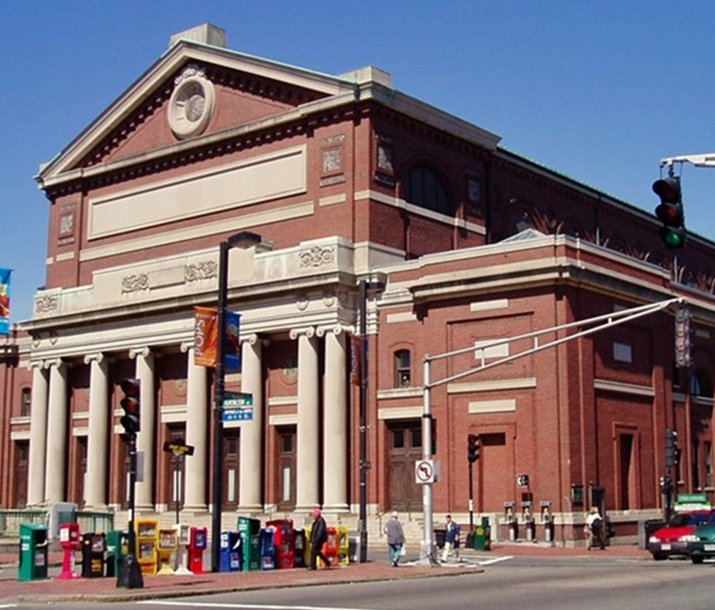
Once we get off our bus/train, we will walk to Symphony Hall. This area is very busy and there will be a lot of people and cars. It will be important to stay with our teachers so we can be safe.

Slide 6
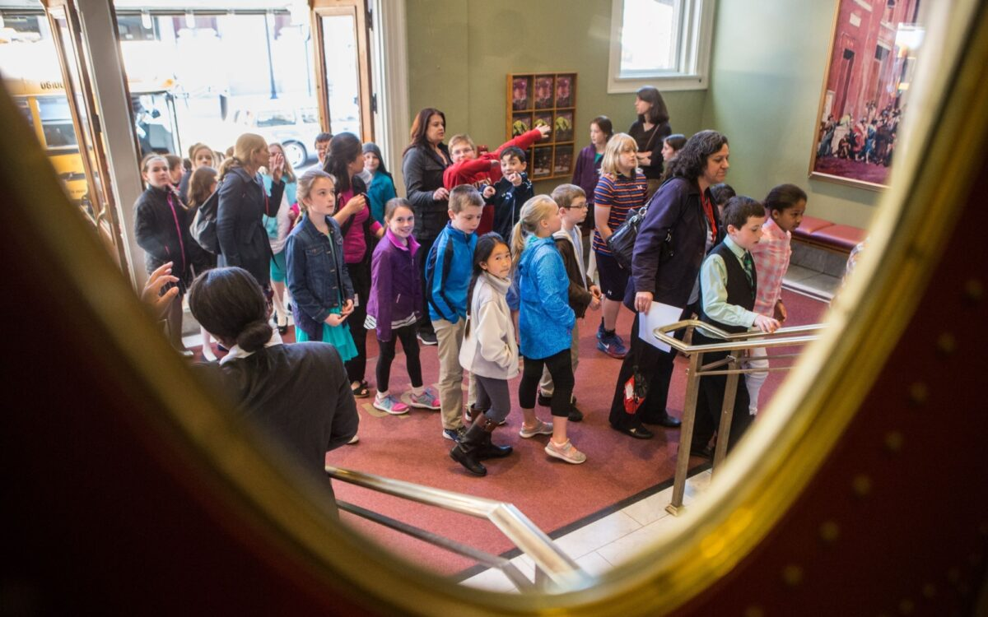
When we enter, someone will check us in. There will be many other people from many other schools, so the lobby may be crowded. I will stay with my class as we walk to the concert hall.

Slide 7
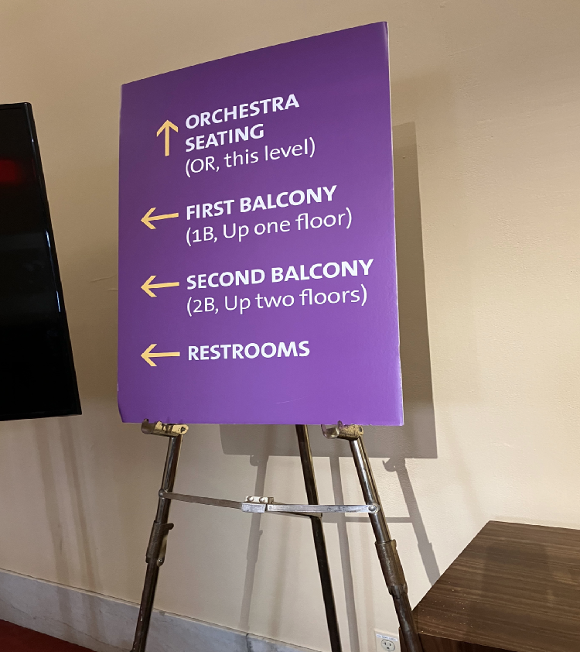
Then we will walk to the concert hall.
Symphony Hall is very big. There will be signs to help to us find our seats.
We may sit close to the stage, or we may sit in a balcony up high! If our seats are in the balcony, we will walk up stairs or take an elevator. I will stay with my class.

Slide 8
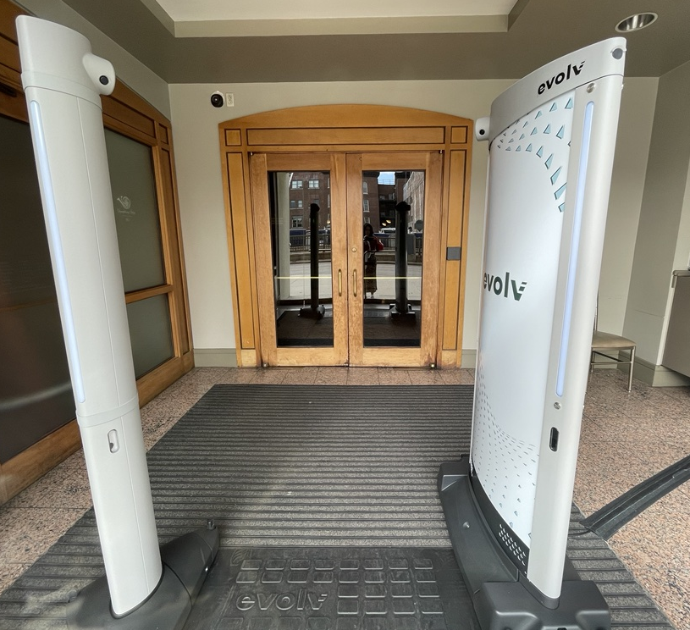
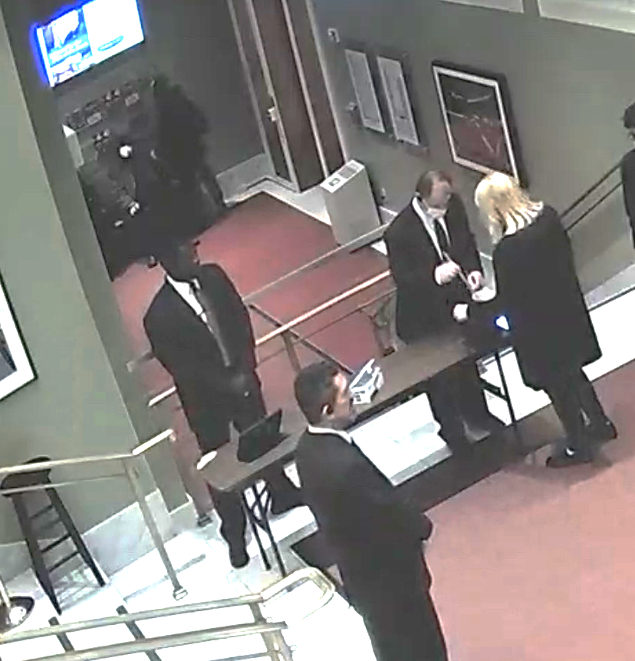
A security team will check our bags and I will walk through a metal detector to keep everyone safe. I will be cooperative.

Slide 9
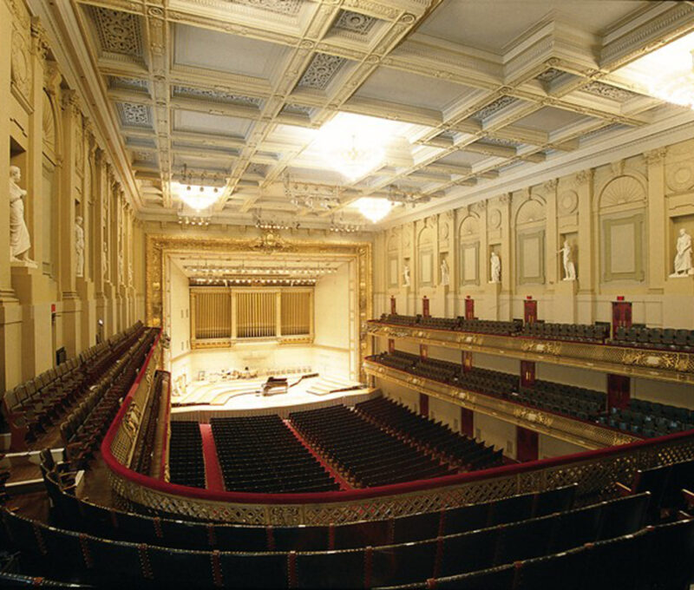
To get to our seats, we may need to walk in front of other people or other people may need to walk in front of us. If someone accidentally bumps me, it is no big deal and I will say “Sorry.” We will do our best to find our seats to get ready for the show.

Slide 10
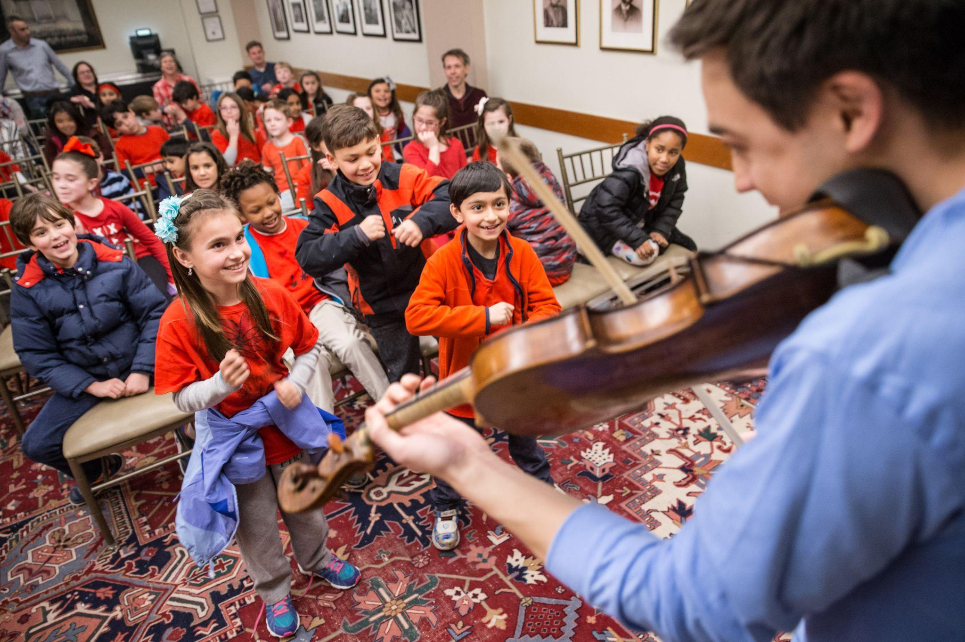
Before or after the concert, we may get to listen to a musician from the orchestra talking about their musical instrument and their life as a musician.
If the presentation has already started when my group arrives, I will enter the room and take my seat quietly. I will listen quietly to the musicians. If I think of a question and don’t get a chance to ask it, I will try to remember it so I can ask it later!

Slide 11
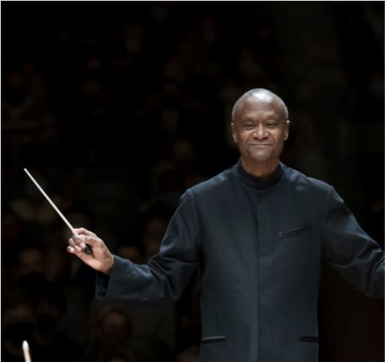
Just before the concert starts, Thomas Wilkins, the conductor, will arrive on the stage. He’s very special and important because he leads the musicians, so we can clap for him!
When the clapping is finished, I will try to be quiet so everyone can focus.
Notes:
Applause image

Slide 12
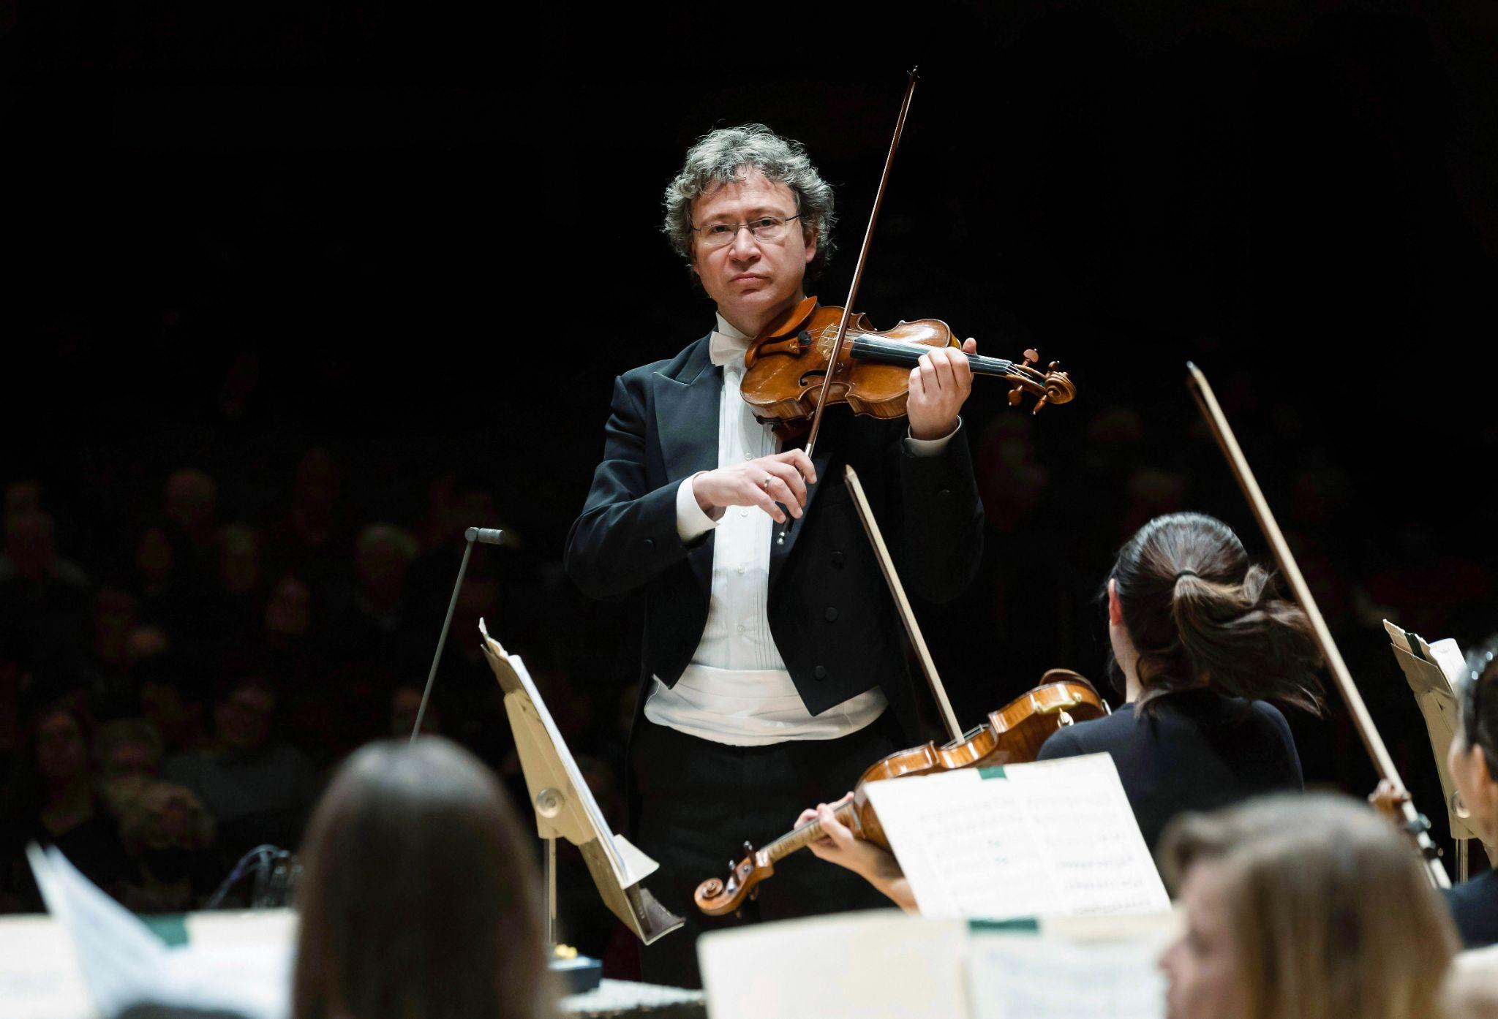
Once I am seated, it is OK to quietly talk to my neighbors. While I am waiting, I may see some of the musicians on stage with their musical instruments. They are getting ready, too!
I will know the concert is about to begin when the concertmaster (a violin player) plays the pitch ‘A’ for the other instruments to tune to. I should remain quiet during tuning so the musicians can hear.

Slide 13
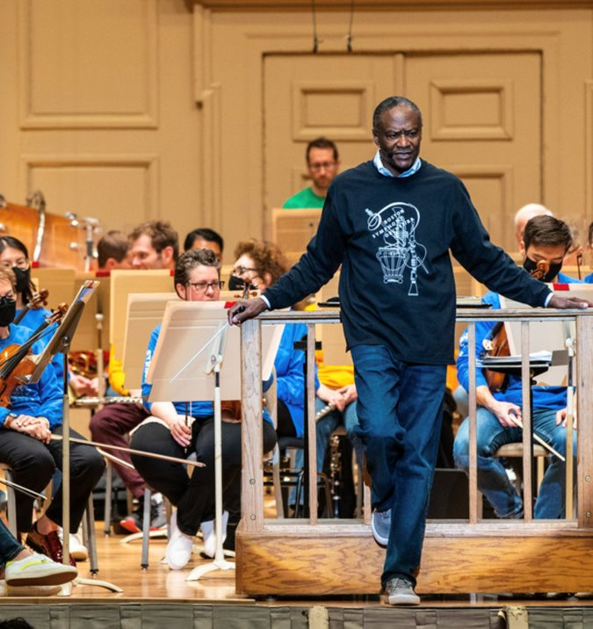
Maestro Wilkins will introduce himself.
He will share information and ideas about the music and composers during the concert.
He might give me hints about what to listen for in the music!

Slide 14
During the concert, we will hear the songs that are on the program. Some moments may be loud or fast, and others may be soft or slow, or even silent. I will listen attentively.
I will wait until Maestro Wilkins puts down his arms and the orchestra gets very quiet before I clap.
Malcolm ARNOLD (1921-2006) Four Scottish Dances: I. Pesante (“Heavily”) Pyotr Ilyich TCHAIKOVSKY (1840-1893) Coronation March Ludwig van BEETHOVEN (1770-1827) Symphony No. 1: IV. Adagio—Allegro molto vivace Julius FUČIK (1872-1916) Entrance of the Gladiators William Grant STILL (1895-1978) Symphony No. 1, Afro-American: II. Sorrow William Grant STILL Symphony No. 1, Afro-American: III. Humor Béla BARTÓK (1881-1945) Concerto for Orchestra: II. Game of couples Bedich SMETANA (1824-1884) The Bartered Bride: Dance of the Comedians

Slide 15
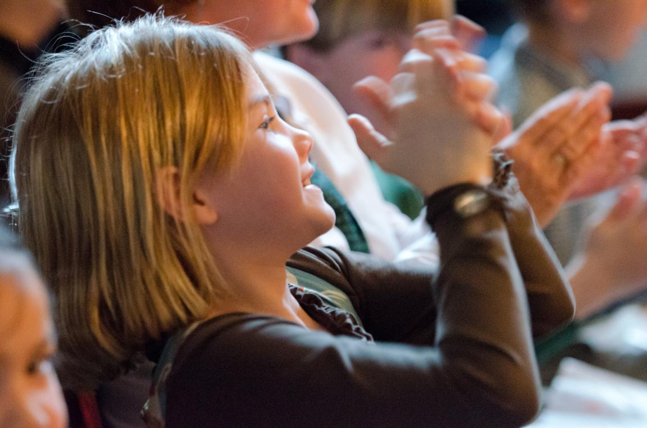
Finally it is time for the orchestra to play for us! When the orchestra is playing, our job is to watch the musicians and listen quietly. After they finish their song, we can clap our hands.

Slide 16
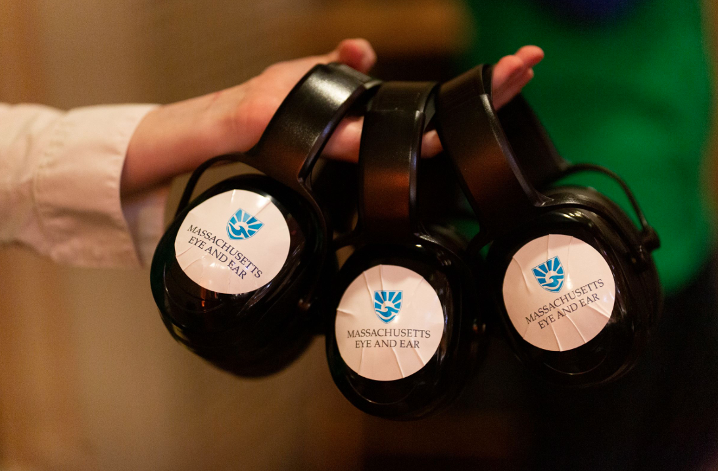
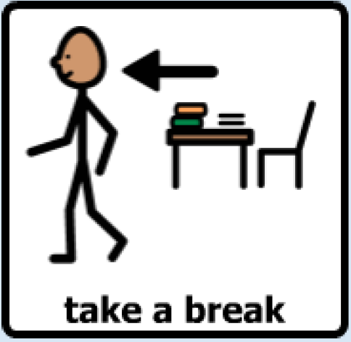
If the music is too loud or the audience is too loud, we can cover our ears or wear our headphones. (The BSO has extras if we need them!) If we need to take a break, use the restroom, or solve a problem, we can ask our teacher between songs.

Slide 17
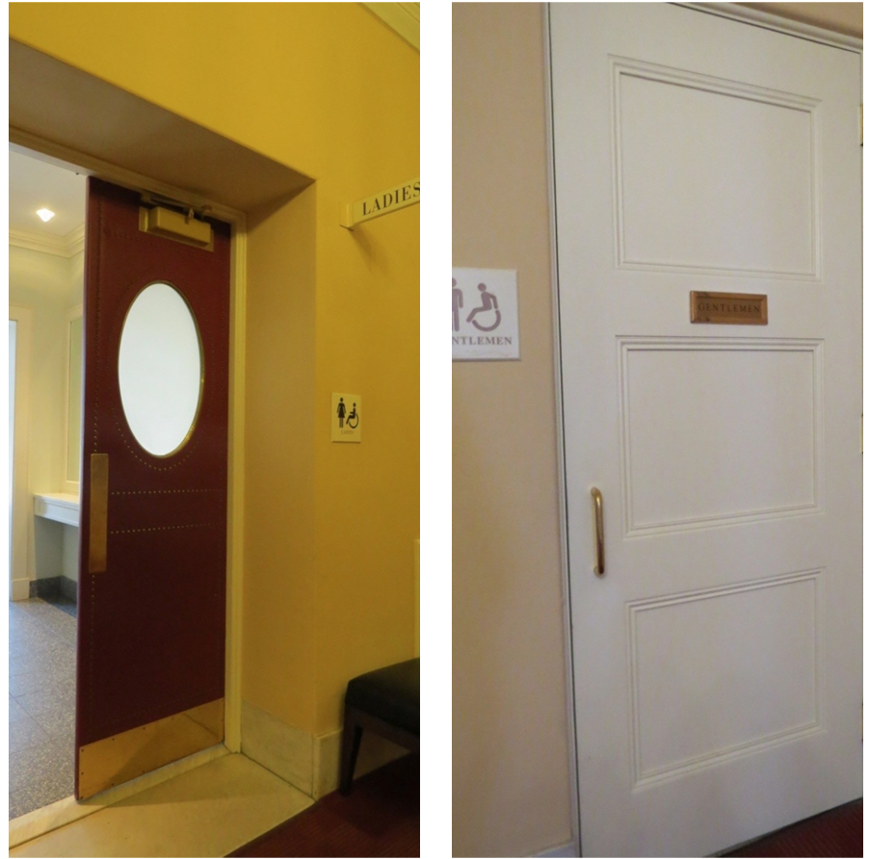
If I start to feel overwhelmed and need a break, I can take a break in the hallway.
The bathrooms are also in the hallways just outside the concert hall. I may have to wait my turn to use the bathroom.

Slide 18
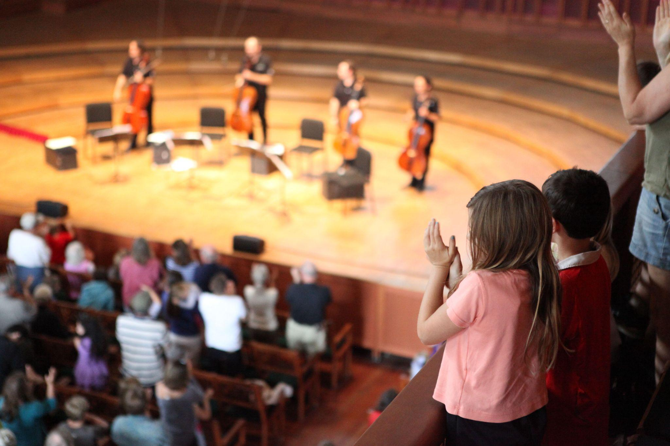
After the very last song, I can stand up and clap to show the orchestra and Maestro Wilkins that I thought they did a great job!
They might bow to thank me for being a good audience member, too!
The clapping may be loud, and it’s OK to wear my headphones or cover my ears if I need to.
Notes:
Applause image

Slide 19
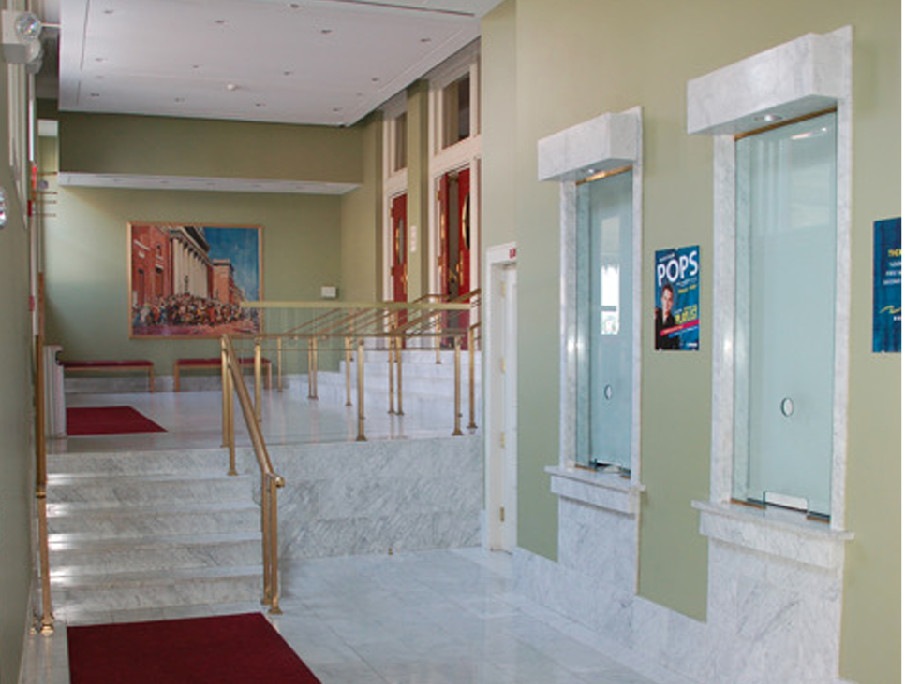
Then the lights will come back on and everyone will start heading toward the exits. I will stay with my class and my teachers. We will wait our turn to use the aisle and exit through the doors. Once we are outside, we will return to our bus/train that will bring us back to school.
Notes:
Applause image

Slide 20
Teachers - please edit this slide for your situation.
Ideas include:
Transportation back
Lunch procedure
What you will do to give the day a sense of closure and to celebrate a successful day at the symphony!

