Slide 1
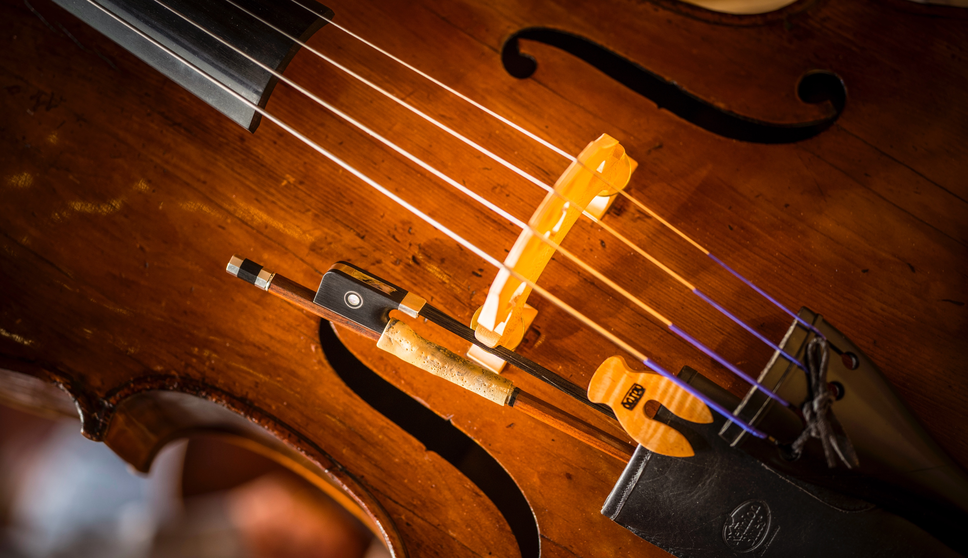
Social Story
I’m Going to a Youth Concert!
bso.org

Slide 2
Notes for Teachers
Social stories serve 2 functions:
Help preview a social situation with your students to reduce anxiety by letting them know what to expect.
Teach students what is expected of them in these situations so they can demonstrate expected behaviors.
Feel free to print and bring this book with you so you can use it in the moment to prompt a student of expected behaviors. Even without the book, you can still use consistent language from this story to remind students of the expectations that have been set.

Slide 3
Notes for Teachers
This social story is designed to be customizable to your unique students and situation.​
On slide 4, please edit the dates to reflect the performance you will be attending.​
On slides 5-6, please edit the text and photo to reflect the transportation your students should be prepared for.​
On slides 20-21, please edit the text and add a photo or image to represent how your students will get back home and what the plan for lunch will be.​
Slide 11 is only relevant if you are attending a pre- or post-concert “Meet the Musician” session. If not, you may delete this slide.​ If you are attending a session, you may edit and/or move this slide so it appears in the correct sequence.
– Lynn Rubin, BSO Educators Advisory Council

Slide 4
On Wednesday/Thursday/Friday, March 19/20/21st I am going on a field trip to see and hear the Boston Symphony Orchestra with my teacher and classmates.​
You might notice the musicians’ colorful shirts. Each “Instrument Family” has its own color!​ (Musicians have new shirts this year. Can you find the differences in color?)

Slide 5
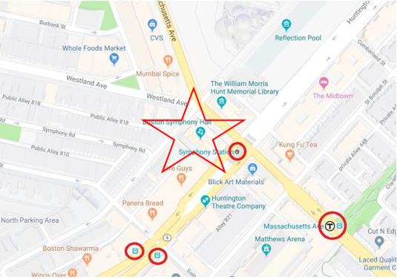
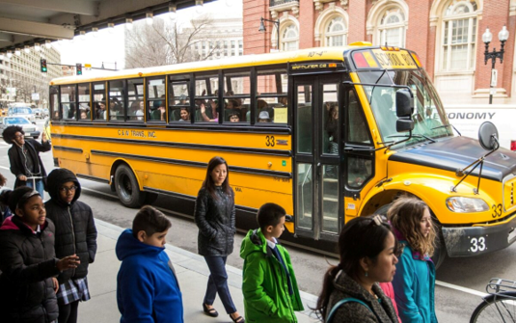
Teachers – please edit this slide for your situation.
Ideas include:
1. Time you will leave school
2. Bus or train expectations
3. Walking down the street expectations

Slide 6
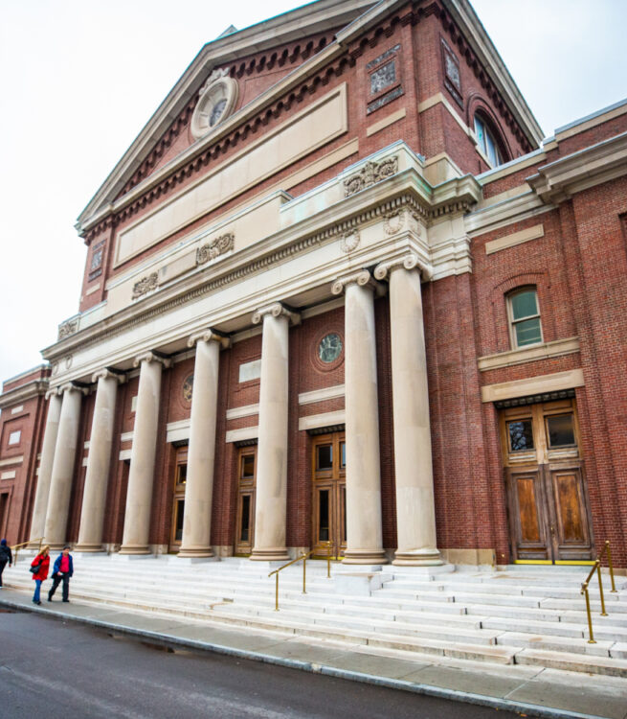
Once we get off our bus/train, we will walk to Symphony Hall. This area is very busy and there will be a lot of people and cars. It will be important to stay with our teachers and buddies so we can be safe.​

Slide 7
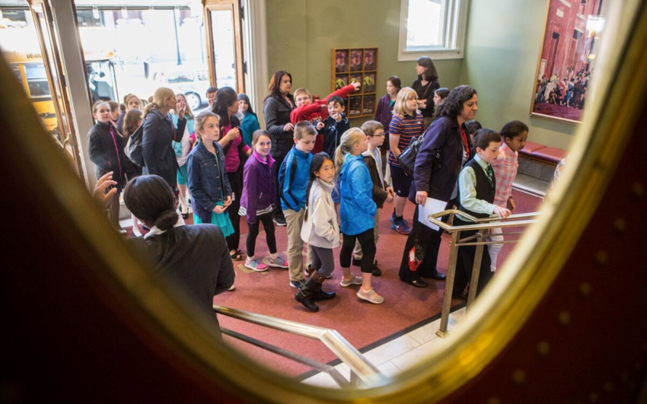
When we enter, an usher wearing a uniform will check us in. There will be many other people from many other schools, so the lobby may be crowded. I will stay with my class as we walk to the concert hall.

Slide 8
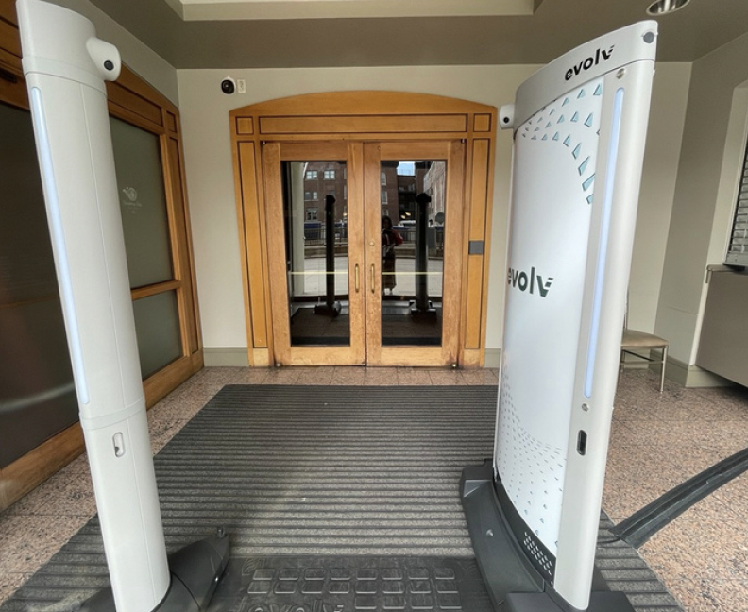
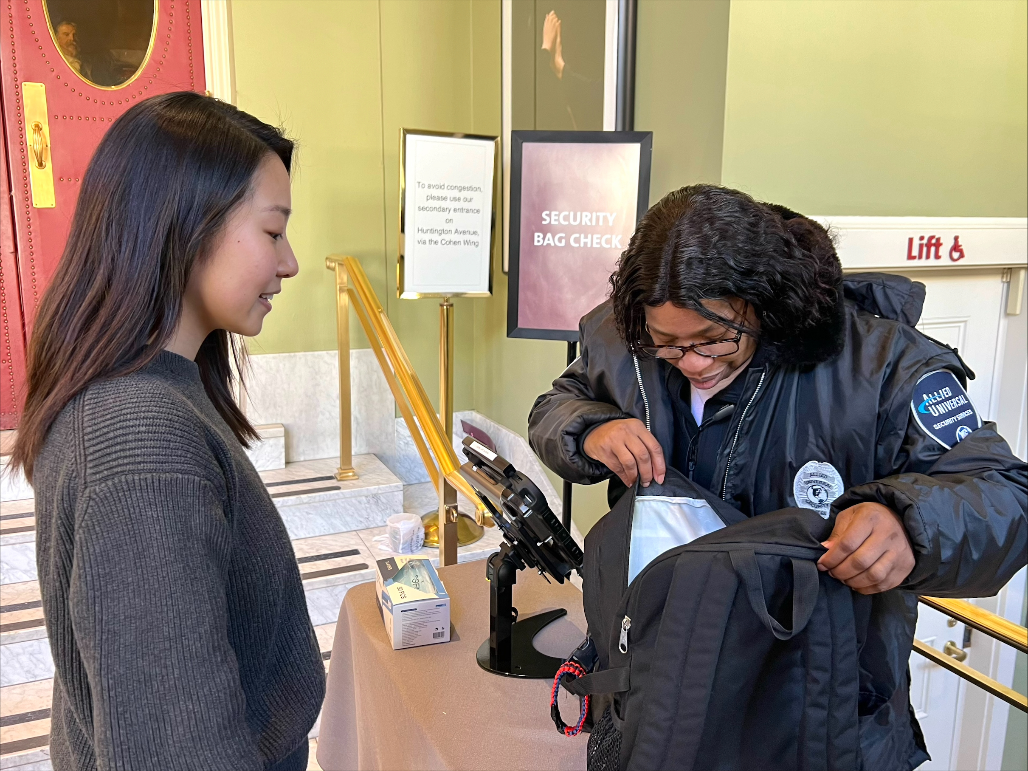
A security team will check our bags and I will walk through a metal detector to keep everyone safe. I will be cooperative.

Slide 9
Then we will walk to the concert hall.
Symphony Hall is very big. There will be signs to help to us find our seats.
We may sit close to the stage, or we may sit in a balcony up high! If our seats are in the balcony, we will walk up stairs or take an elevator. I will stay with my class.

Slide 10
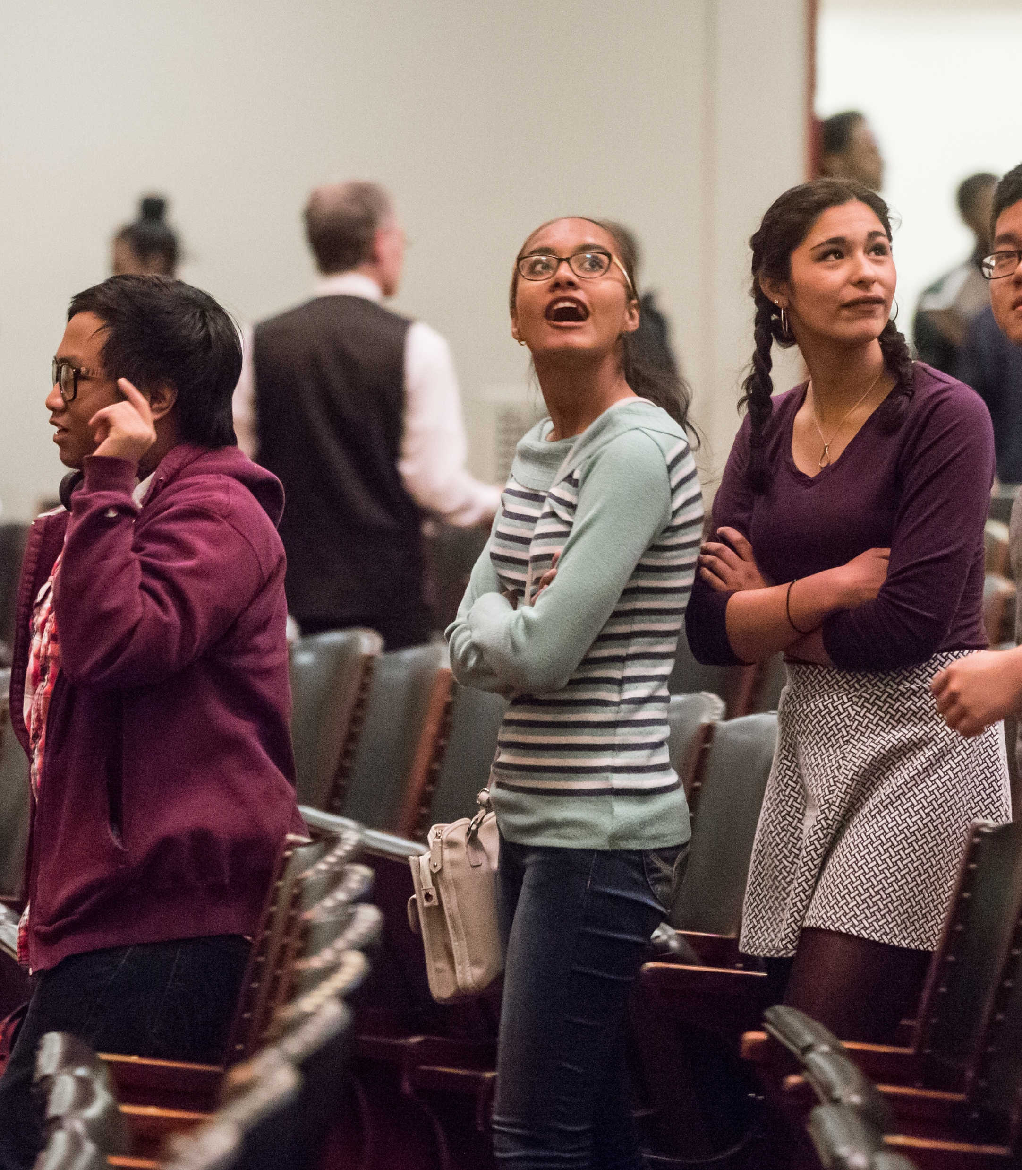
To get to our seats, we may need to walk in front of other people or other people may need to walk in front of us.
If someone accidentally bumps me, it is no big deal and I will say “Sorry.” We will do our best to find our seats to get ready for the show.

Slide 11
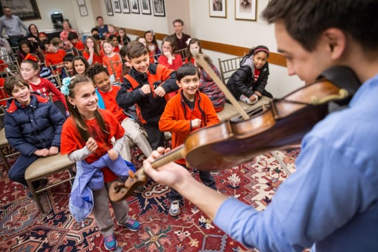
Before or after the concert, we may get to listen to a musician from the orchestra talking about their musical instrument and their life as a musician. (If we go before the concert, this will happen in the concert hall. If we go after the concert, it will happen in a different room.)
If the presentation has already started when my group arrives, I will enter the room and take my seat quietly. I will listen quietly to the musicians. If I think of a question and don’t get a chance to ask it, I will try to remember it so I can ask it later!

Slide 12
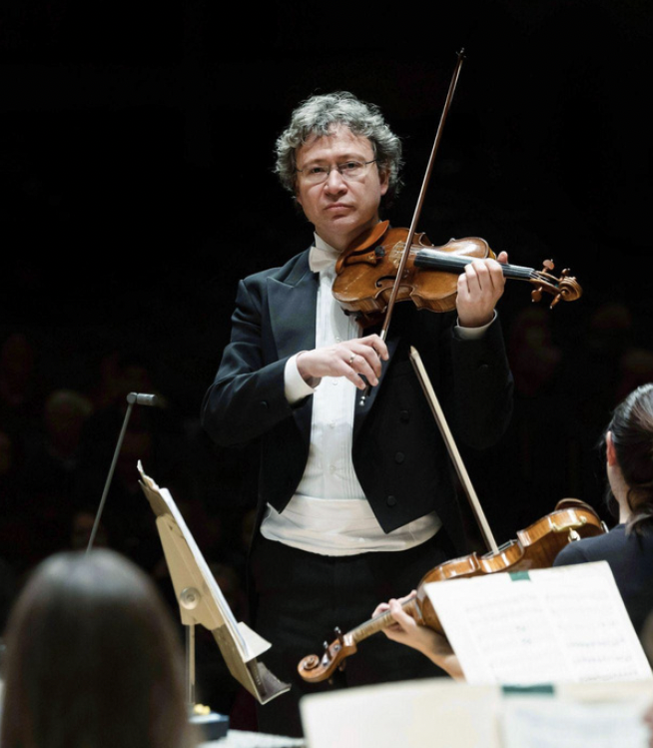
Once I am seated, it is OK to quietly talk to my neighbors. While I am waiting, I may see some of the musicians on stage with their musical instruments. They are getting ready, too!
I will know the concert is about to begin when the concertmaster (a violin player) plays the pitch ‘A’ for the other instruments to tune to. I will remain quiet during tuning so the musicians can hear.

Slide 13
Just before the concert starts, Thomas Wilkins, the conductor, will arrive on the stage. He’s very special and important because he leads the musicians, so we can clap for him!
When the clapping is finished, I will try to be quiet so everyone can focus.

Slide 14
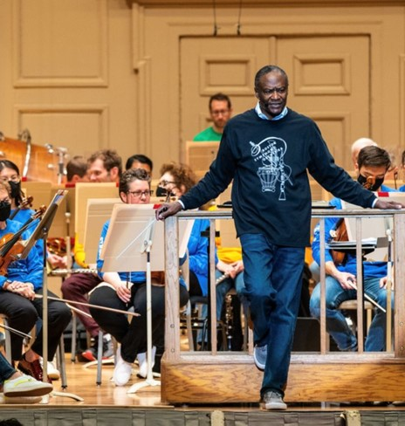
Maestro Wilkins will introduce himself.
He will share information and ideas about the music and composers during the concert.
He might give me hints about what to listen for in the music!

Slide 15
STRAVINSKY Firebird Suite: Infernal Dance SHOSTAKOVICH Festive Overture GOUNOD Petite Symphonie: Scherzo BONDS Montgomery Variations: Dawn in Dixie Carlos SIMON Four Black American Dances: Ring Shout GRIEG Peer Gynt Suite: In the Hall of the Mountain King STRAVINSKY Firebird Suite: Berceuse and Finale
During the concert, we will hear the songs that are on the program. Some moments may be loud or fast, and others may be soft or slow, or even silent. I will listen attentively.
I will wait until Maestro Wilkins puts down his arms and the orchestra gets very quiet before I clap.

Slide 16
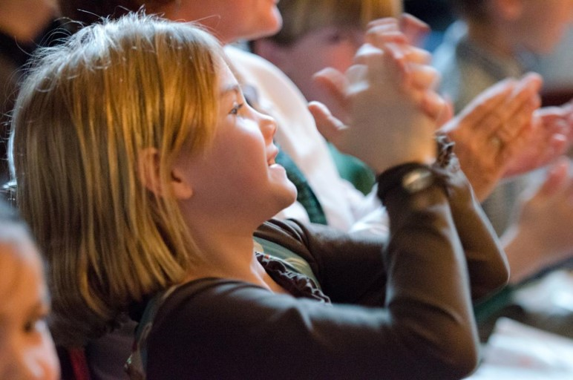
Finally, it is time for the orchestra to play for us! When the orchestra is playing, our job is to watch the musicians and listen quietly. After they finish their song, we can clap our hands.

Slide 17
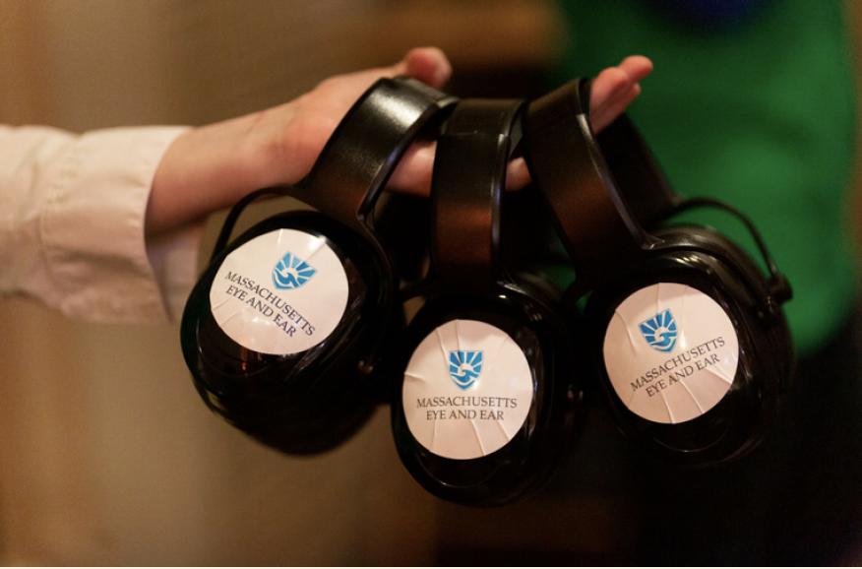
If the music or the audience is too loud, I can cover my ears or wear my noise-reduction headphones. (The BSO has extras if I need them!) If I need to take a break, use the restroom, or solve a problem, I can ask my teacher between songs.

Slide 18
If I start to feel overwhelmed and need a break, I can take a break in the hallway or in a Quiet Space.
The bathrooms are also in the hallways just outside the concert hall. I may have to wait my turn to use the bathroom.

Slide 19
After the very last song, I can stand up and clap to show the orchestra and Maestro Wilkins that I thought they did a great job!
They might bow to thank me for being a good audience member, too!
The clapping may be loud, and it’s OK to wear my headphones or cover my ears if I need to.

Slide 20
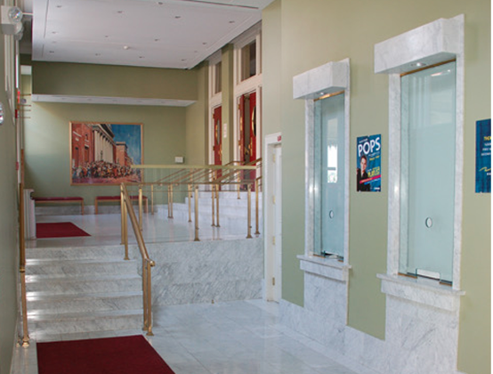
Then, the lights will come back on and everyone will start heading toward the exits. I will stay with my class and my teachers. We will wait our turn to use the aisle and exit through the doors.
Once we are outside, we will return to the bus/train that will bring us back to school.

Slide 21
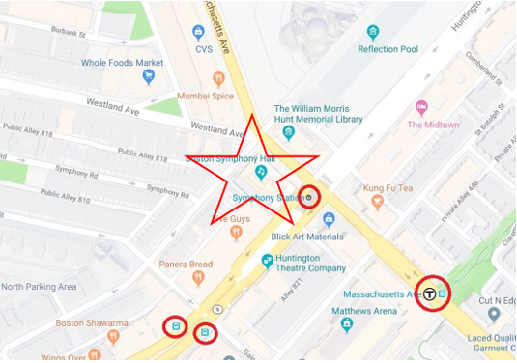
Teachers - please edit this slide for your situation. Ideas include:
Transportation back
Lunch procedure
What you will do to give the day a sense of closure and to celebrate a successful day at the symphony!

